Slide 1
数据表对比
Zipkin Cassandra3 |  | Zipkin V1 |  | Jaeger
表名 | 索引 | 表名 | 索引 | 表名 | 索引
span | (trace_id, ts_uuid, id) | traces | (trace_id, ts, span_name) | traces | trace_id
 | annotation_query (SASIIndex) | service_names | service_name | service_names | service_name
 | l_service (SASIIndex) | span_names | (service_name, bucket) | operation_names | service_name
span_by_service | (service, span) | service_name_index | (service_name, bucket) | service_operation_index | (service_name, operation_name)
trace_by_service_span | (service, span, bucket) | service_span_name_index | (service_span_name, ts, trace_id) | service_name_index | (service_name, bucket)
 | duration (SASIIndex) | annotations_index | (annotation, bucket) | duration_index | (service_name, operation_name, bucket)
dependency | (day, parent, child) | dependencies | day | tag_index | (service_name, tag_key, tag_value)
 |  |  |  | dependencies | ts
 |  |  |  |  | ts_index(SASIIndex)

Slide 2
GET /traces?annotationQuery=error&limit=10&lookback=3600000&minDuration=100&serviceName=getorders&sortOrder=duration-desc&spanName=get_orders
Zipkin JSON API
API | 功能 | 实现方法
/services | 查询所有service列表 | SELECT service FROM span_by_service
/spans?serviceName= | 查询service下面所有方法名 | SELECT span FROM span_by_service WHERE service='userlogin'
/traces | 查询trace列表 | 多次查询，然后求trace_id交集： SELECT trace_id FROM span WHERE annotation_query like ‘%entry_service=bbs%‘ AND ts_uuid > xxx LIMIT 10; （复合条件如 http.path=/foo and error， 会有两个并行查询） SELECT trace_id FROM trace_by_service_span WHERE service=‘getorders’ AND span=‘’ AND bucket=17710; （存储span值时，会多存一条span为空的记录。选择一个时间段，会换算成多个bucket值多次查询。如果不指定service值，则会从span_by_service表查询所有services，再组合成多次查询。 执行 QueryRequest.test 对每条数据过滤。 将合并去重的trace_id拿到span表查询trace，并在内存中过滤其它如duration、sort等条件，加 ALLOW FILTERING 条件。 CassandraSpanStore.java : getTraces()
/dependencies | 依赖树查询 | SELECT * FROM dependency WHERE day={today} 在内存中构建依赖树结构
/trace/{traceId} | 查询单条trace | SELECT * FROM span WHERE trace_id='5b34487f41fff69eaaef1db1bda0ab7b'
Spark Job | 生成依赖树 | 全量查询span表，在内存中聚合计算，一天运行一次

Slide 3
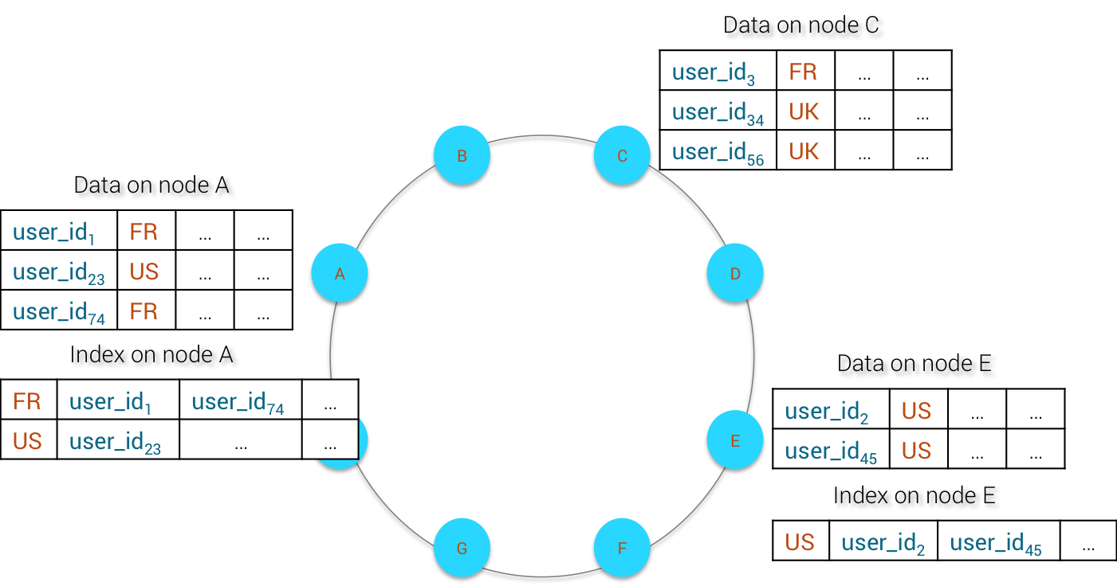
SASIIndex
SASIIndex = SSTable Attached Secondary Index
与Secondary Index类似，生命周期与SSTable同步
mode
PREFIX
CONTAINS
SPARSE
anaylzers
NonTokenizingAnalyzer
StandardAnalyzer
case_sensitive
true
false

Slide 4
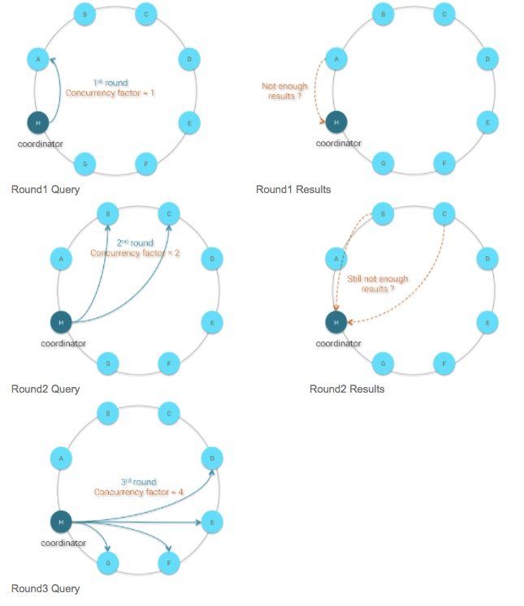
Range Scan Query
为什么唯一性越高的字段，相应的二级索引查询效率越差？
为了避免节点太多， 一次性返回给coordinator节点的数据量太大，造成带宽瓶颈
分多次，分别从一些节点查询一些数据回来，如果返回的结果条数已满足要求，则放弃再到后面的节点继续查询
如果唯一性很高的字段，假如1000个节点中只有两个节点有某个值，则可能完成这个值 的查找，需要进行几十次的网络请求
对我们这种事后分析型应用场景，貌似可以接受

Slide 5
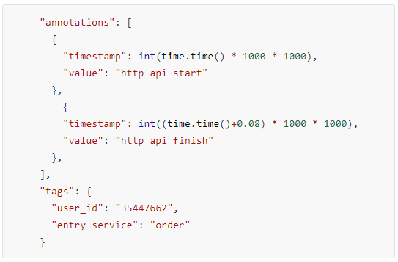
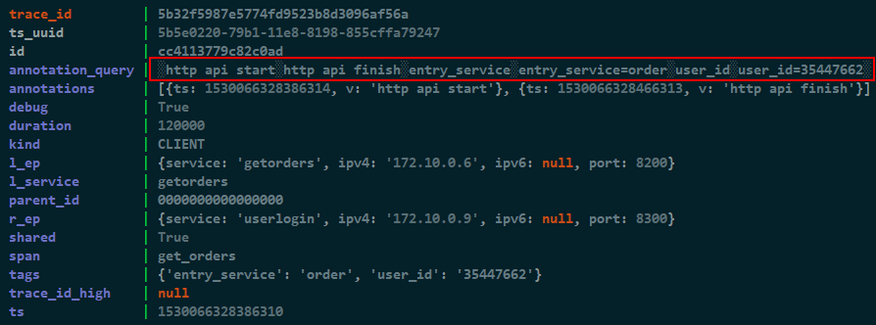
annotation_query
用特殊符号░拼接annotations与tags字段
查询的时候直接查询： "%░" + annotationKey + "░%“
SASIIndex 索引，mode=CONTAINS
CassandraUtil.java : annotationQuery()

Slide 6
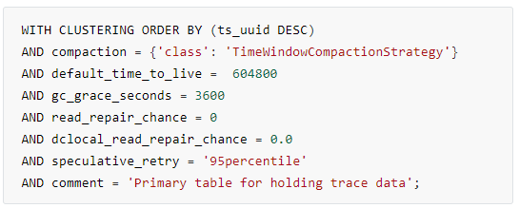
表定义分析
compaction策略
LeveledCompactionStrategy
SizeTieredCompactionStrategy
TimeWindowCompactionStrategy
DateTieredCompactionStrategy
default_time_to_live
数据存活时间，超过这个值的数据，会在compaction过程中被删除掉
gc_grace_seconds
如果一个节点挂掉，再恢复时，会丢失这个值之前时间点的数字修改（删除、更新）操作
修复不一致的数据（如果没有读请求落到该数据时）
read_repair_chance
dclocal_read_repair_chance
读取数据后，再异步修复脏数据机制。设置为0表示不做修复动作，适合APM场景
speculative_retry
ALWAYS
10ms
99percentile
Xpercentile: Cassandra constantly tracks each table's typical read latency (in milliseconds). If you set speculative retry to Xpercentile, Cassandra sends redundant read requests if the coordinator has not received a response after X percent of the table's typical latency time.
durable_writes
设置成false后，不写入commit log，断电可能有数据丢失

Slide 7
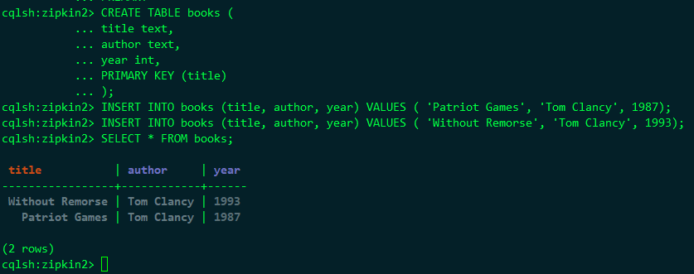
Cassandra 存储模型
唯一主键
Row Key: Without Remorse
(name=author, value=Tom Clancy, timestamp=1393102991499000)
(name=year, value=1993, timestamp=1393102991499000)
Row Key: Patriot Games
(name=author, value=Tom Clancy, timestamp=1391029914991000)
(name=year, value=1989, timestamp=1391029914991000)
Notes:
cqlsh:zipkin2> CREATE TABLE books (
... title text,
... author text,
... year int,
... PRIMARY KEY (title)
... );
cqlsh:zipkin2> INSERT INTO books (title, author, year) VALUES ( 'Patriot Games', 'Tom Clancy', 1987);
cqlsh:zipkin2> INSERT INTO books (title, author, year) VALUES ( 'Without Remorse', 'Tom Clancy', 1993);
cqlsh:zipkin2> SELECT * FROM books;

Slide 8
Cassandra 存储模型
联合主键
Row Key: Tom Clancy
(name=1993:Without Remorse:isbn, value=0-399-13825-0)
(name=1993:Without Remorse:publisher, value=Putnam)
(name=1987:Patriot Games:isbn, value=0-399-13241-4)
(name=1987:Patriot Games:publisher, value=Putnam)
Notes:
cqlsh:zipkin2> CREATE TABLE authors (
... name text,
... year int,
... title text,
... isbn text,
... publisher text,
... PRIMARY KEY (name, year, title)
... ) WITH CLUSTERING ORDER BY (year DESC);
cqlsh:zipkin2> INSERT INTO authors (name, year, title, isbn, publisher) VALUES ('Tom Clancy', 1987, 'Patriot Games', '0-399-13241-4', 'Putnam');
cqlsh:zipkin2> INSERT INTO authors (name, year, title, isbn, publisher) VALUES ('Tom Clancy', 1993, 'Without Remorse', '0-399-13825-0', 'Putnam');
cqlsh:zipkin2> SELECT * FROM authors;

Slide 9
Cassandra 存储模型
联合Partition Key
Row Key: Tom Clancy:1993
(name=Without Remorse:isbn, value=0-399-13825-0)
(name=Without Remorse:publisher, value=Putnam)
Row Key: Tom Clancy:1987
(name=Patriot Games:isbn, value=0-399-13241-4)
(name=Patriot Games:publisher, value=Putnam)
更复杂的索引情况：
Lists
Sets
Maps
Notes:
cqlsh:zipkin2> CREATE TABLE authors (
... name text,
... year int,
... title text,
... isbn text,
... publisher text,
... PRIMARY KEY ((name, year), title)
... );
cqlsh:zipkin2> INSERT INTO authors (name, year, title, isbn, publisher) VALUES ('Tom Clancy', 1987, 'Patriot Games', '0-399-13241-4', 'Putnam');
cqlsh:zipkin2> INSERT INTO authors (name, year, title, isbn, publisher) VALUES ('Tom Clancy', 1993, 'Without Remorse', '0-399-13825-0', 'Putnam');
cqlsh:zipkin2> SELECT * FROM authors;

Slide 10
Consistency Level
写操作的Consistency Level
级别 | 描述
ONE | 任意一个replica节点写操作已经成功。
LOCAL_ONE | 任何一个本地数据中心内的replica节点写操作成功。
LOCAL_QUORUM | 本地数据中心内quorum数量的replica节点写操作成功。避免跨数据中心的通信。
EACH_QUORUM | 写操作必须将指定行的数据写到每个数据中心的quorum数量的replica节点的commit log和memtable。
ALL | 写操作必须将指定行的数据写到所有replica节点的commit log和memtable。
LOCAL_SERIAL | 本地数据中心内quorum数量的replica节点有条件地（conditionally）写成功。用于轻量级事务
读操作的Consistency Level
ALL
ONE、LOCAL_ONE
TWO、THREE
QUORUM、LOCAL_QUORUM
SERIAL、LOCAL_SERIAL

Slide 11
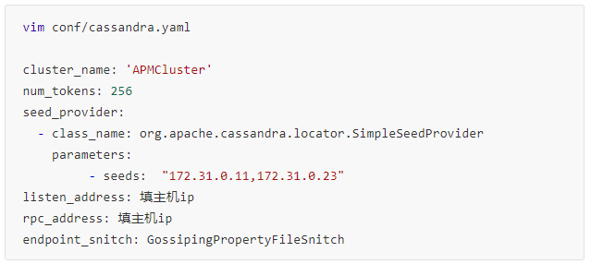
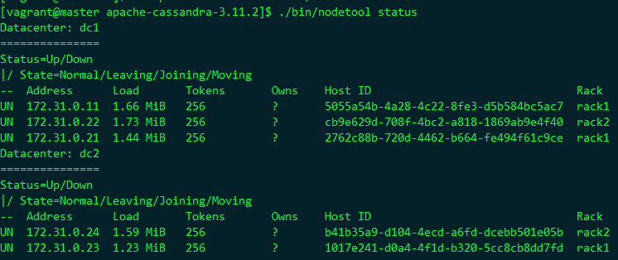
Cassandra 部署
每个节点配置文件
每个节点配置datacenter与rack
启动节点
sudo salt "*" cmd.run "/home/vagrant/apache-cassandra-3.11.2/bin/cassandra" runas="vagrant“
查看节点状态
$ ./bin/nodetool status
执行CQL
CQLSH_HOST=172.31.0.23 ./bin/cqlsh

Slide 12
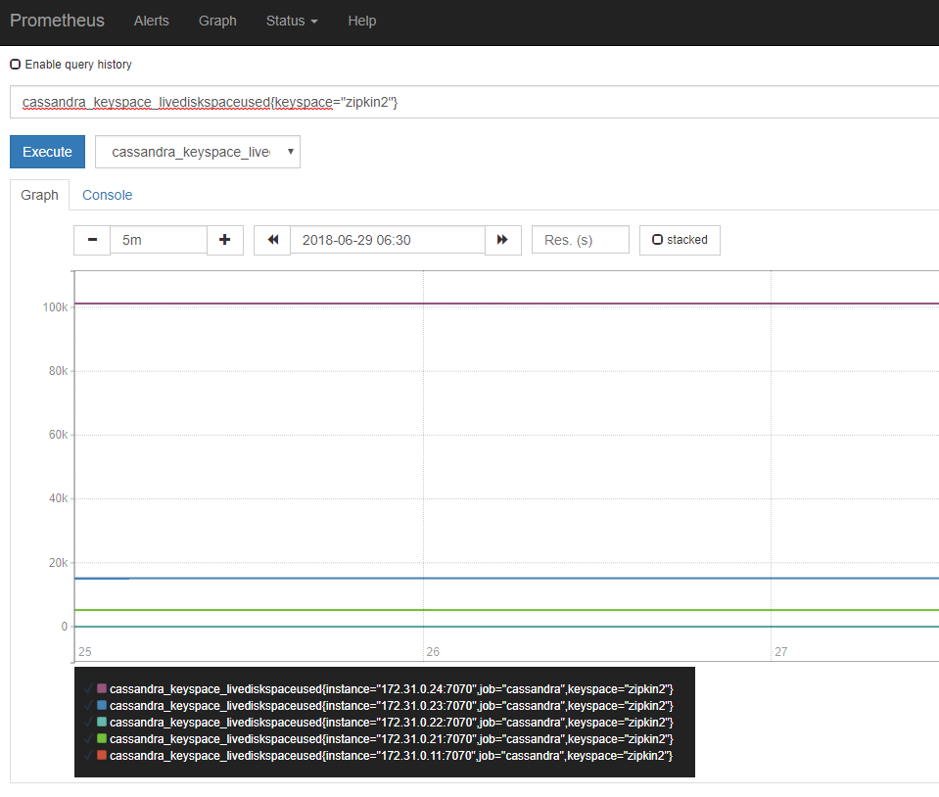
Cassandra 监控
通过JMX Exporter暴露监控指标给Prometheus
cd apache-cassandra-*
wget https://repo1.maven.org/maven2/io/prometheus/jmx/jmx_prometheus_javaagent/0.3.0/jmx_prometheus_javaagent-0.3.0.jar
wget https://raw.githubusercontent.com/prometheus/jmx_exporter/master/example_configs/cassandra.yml
echo 'JVM_OPTS="$JVM_OPTS -javaagent:'$PWD/jmx_prometheus_javaagent-0.3.0.jar=7070:$PWD/cassandra.yml'"' >> conf/cassandra-env.sh
./bin/Cassandra
查看指标： curl http://127.0.0.1:7070
配置Prometheus拉取指标
配置prometheus.yml，添加 scrape_config项
- job_name: cassandra
static_configs:
- targets: ['172.31.0.11:7070', '172.31.0.21:7070',
'172.31.0.22:7070', '172.31.0.23:7070', '172.31.0.24:7070']
Nodetool监控
$ ./bin/nodetool tpstats
$ ./bin/nodetool tablehistograms zipkin2.authors
$ ./bin/nodetool netstats

Slide 13
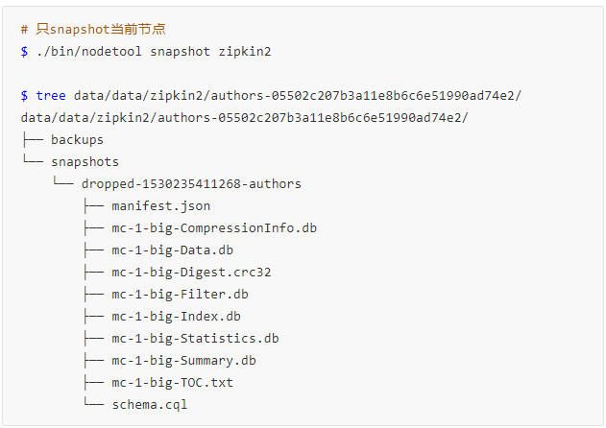
Cassandra 备份
生成的snapshots文件不会自动删除，所以在手动snapshot之前，可以先把老的删除掉：
# 清除本机的snapshot，其它节点无影响
$ nodetool -h localhost -p 7199 clearsnapshot
恢复备份
首先需要确保表结构存在
Truncate表
复制最新的snapshot文件夹到keyspace/table_name-UUID目录中
运行 ./bin/nodetool refresh

Slide 14
APM 对比
APM框架 | 存储层 | 特色
Zipkin | ElasticSearch、MySQL、Cassandra | Spark Job定时聚合数据 其它编程语言支持较好
SkyWalking | ElasticSearch | 兼容zipkin协议 在Collector中通过stream实时聚合分析数据
PinPoint | HBase
Jaeger | Cassandra、ElasticSearch | Spark Job定时聚合数据 UI友好

